Slide 1
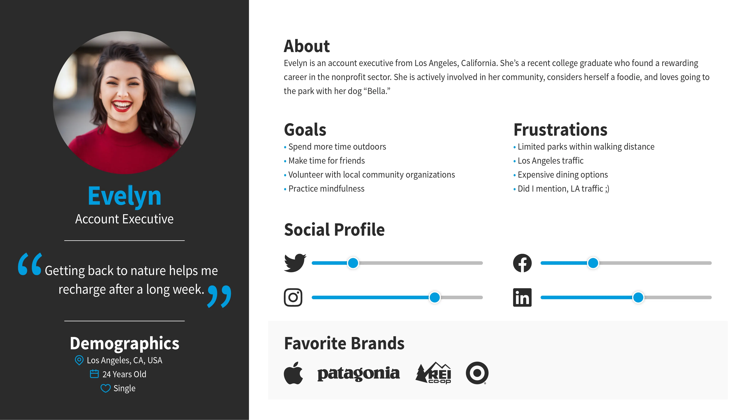
Insert About section. This should be a story about the user which brings them to life
Insert 3 to 4 goals, they should be related to the person’s life goals and how your business goals align to their needs
Insert 3 to 4 frustrations, they should be related to the person’s life goals and how your business goals align to their needs
Name
Occupation
Motivations
“Insert Quote from Persona."
Insert 3 to 4 motivations
Age:
Gender:
Location:

